Slide 1
Nasonex® Direct-to-Consumer TV Advertising:
Sales Impact & Return-on-Investment Evaluation
Senthil Murugan, Jane Folske & Shirley Wang
Promotion Response Analytics
Commercial Analytics, IM&DS
Operations, Commercial Operations
April 13th, 2010

Slide 2
Background
The objective of this project is to estimate sales impact and return-on-investment for Nasonex® direct-to-consumer television advertising using marketing mix modeling.
This project is part of a work stream requested by the new Merck U.S. leadership team to inform 2010 investment decisions for Nasonex® and other TV brands using a consistent methodology across legacy Merck and legacy Schering-Plough franchises.
  This is an update for Nasonex® as marketing mix modeling was performed for this brand in the past. The planned approach is “harmonized” with methods used by legacy Merck for other TV brands in the past.
Nasonex® media have been purchased through 2Q2010. This analysis will help to inform investment levels for TV advertising for Nasonex® in 2S2010 and beyond.
  To be leveraged appropriately for making resource allocation decisions, these retrospective results need to be interpreted in the context of future potential patients, brand messages, competitive dynamics, market events, product life cycle, and other influences.

Slide 3
Executive Summary
This analysis estimates sales impact and ROI for investment in DTC TV advertising for Nasonex® based upon the historical time period of May 2008 through October 2009, leveraging Nielsen Gross Ratings Points while controlling for prior month sales, seasonality and concurrent promotions.
Incremental Revenue:
  Nasonex® DTC TV advertising during the analysis period is estimated to have contributed approximately $216 MM to before tax total sales.
  On the after-tax basis the contribution is approximately $130 MM.
Program Cost:
  Before tax cost of the campaign during the analysis period of 18 months is $54.6 MM. On the after-tax basis the campaign cost is approximately $32.8 MM.
ROI:
  The campaign results in a ROI of 4:1, indicating that approximately $4 was earned for every dollar invested in Nasonex® TV advertising.

Slide 4
Approach
This analysis studies the impact of Nasonex® TV advertisements on the NRx Volume.
The analysis period is from May 2008 to October 2009 (18 months).
Monthly Rx and promotional data aggregated at the DMA level were used in the analysis.
During the analysis period, the new Customer Centric Selling Model was introduced (Oct/08) and overall field promotions for Nasonex® changed. This analysis implicitly controls for such field promotional changes. It also controls for impacts due to other promotions such as samples, vouchers, e-details and tele-symposia programs.
Effects of TV DTC campaigns by other products like Singulair®, Advair, Zyrtec and Clarinex were also considered in the analysis.

Slide 5
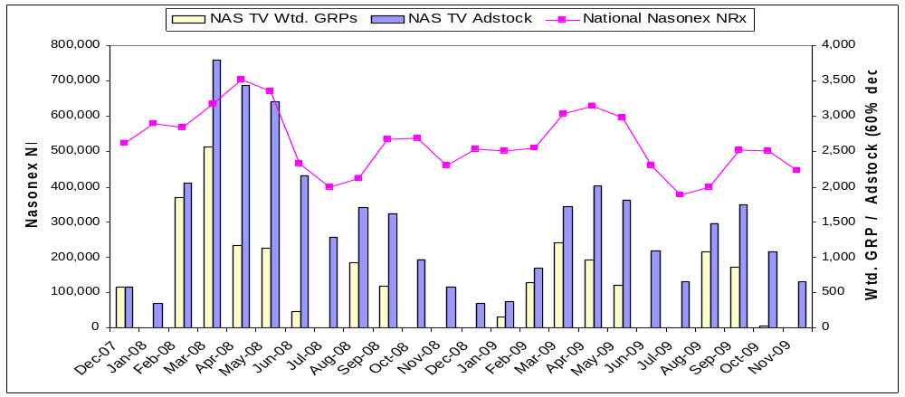
Analytical Time Period
The analytical period assessed in this analysis is May 2008 through October 2009. GRPs are transformed to adstock to capture the lagged effects of TV on NRx volume. The NRx and GRPs vary similarly with peaks during seasonal months. From Q4-2008, the GRPs are reduced when compared to previous levels.
Study period Starts here
Study period Ends here
Secondary Seasonal Month
CCSM Launched
Primary Allergy Season

Slide 6
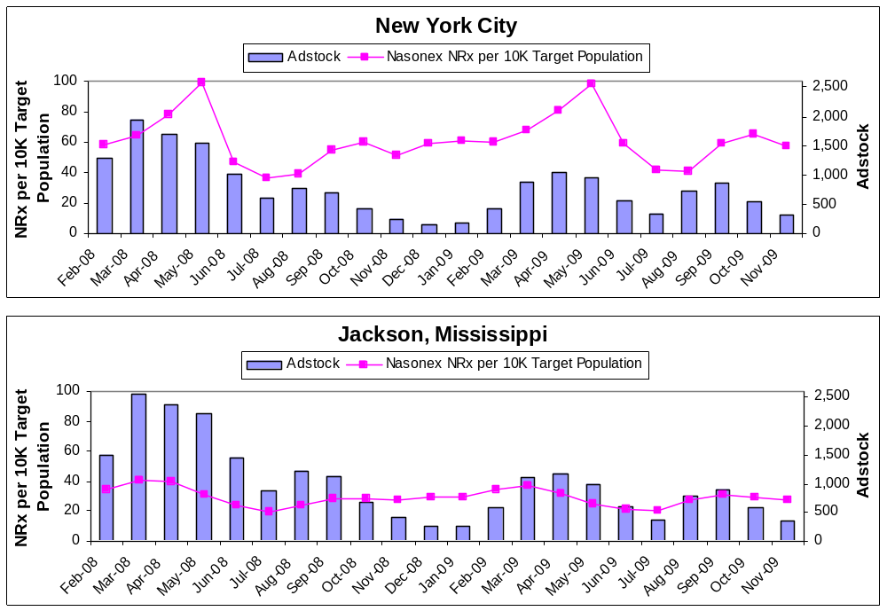
Visualization of Method
The effect of DTC TV advertising on sales is evaluated using 101 time series* like these as input, all assessed simultaneously to estimate increase in NRx corresponding to increase in GRP adstock while controlling for baseline scriptwriting, other promotions, seasonality and market events.
In August 2008, Nasonexl® had 762 GRP Adstock of exposure in NYC and 1,226 Adstock of exposure in Jackson, Mississippi. Such differences in exposure across DMAs are leveraged in the modeling process to quantify corresponding differences in sales volume.
In Jackson Mississippi, exposure of the branded campaign ranged from 243 to over 2,557 in terms of GRP Adstock. Such differences in exposure across time are leveraged in the modeling process, exploiting the peaks and valleys in exposure to look for corresponding peaks and valleys in volume.
* Approximately 85% of the US target population reside in these DMAs.

Slide 7








Modeling Process Summary
Time-series cross sectional regression models estimate incremental monthly-DMA level NRx volume due to brand TV advertising while controlling for prior NRx volume, field promotion, market events, and competitive advertising.
Product NRxs
DMA Population
Nasonex
GRP Adstock
Competitors
GRP Adstock
Concurrent
Promotions
# of Prescribers
Pre-period
Product NRxs
DMA Population
Variables for Seasonality and Market Events
# of potential
=
+
+
+
+
Nasonex NRx for a given month within a DMA per 10K adults in 21-60 age group in the DMA is calculated to “population normalize” scripts, effectively putting DMA-month level prescription volume on a common scale across DMA.
Adstocks created from Nasonex GRPs are already on a common reach-like scale.
Other promotional variables (details, samples, vouchers, events) per 1,000 prescribers in the DMA are computed to normalize the promotional variables across DMAs.
Carryover script writing regardless of promotions is accounted by including normalized pre-period Nasonex NRx.
Seasonal months like March, April and September were explicitly controlled. The month of December was included to control for under prediction by the model when the GRP is low.
Singulair® TV ad exposures were explicitly controlled. Other products like Advair, Zyrtec and Clarinex TV ads were not included as they did not yield statistically significant estimates.
The output is the average incremental NRx volume per month per 10K target population.

Slide 8
Technical Notes
The estimates from this analysis were compared with other industry standard models used by legacy SP in the past.
  The mean ROI estimate from the current analysis agrees well with other approaches.
  The confidence interval of the ROI estimates is narrower than those obtained by other approaches.
The model used in the analysis uses linear term for Nasonex Adstock. A quadratic term did not yield typical inverted U shape, suggesting that the experience range in Nasonex TV ad during the study period may not contain saturation.
Non-parametric methods were used to study the functional form of impact. The non- parametric study suggests that saturation may not have been achieved in the experience range. Non-parametric studies are also helpful in identifying approximate optimal investment level for increasing revenue.

Slide 9
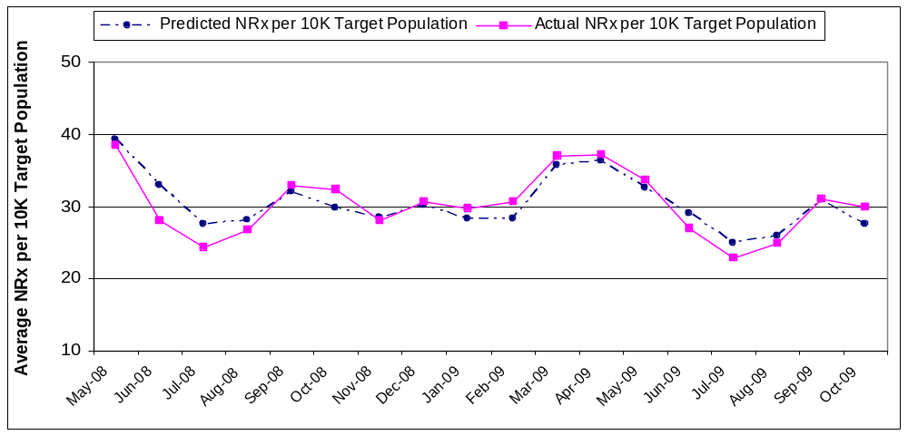
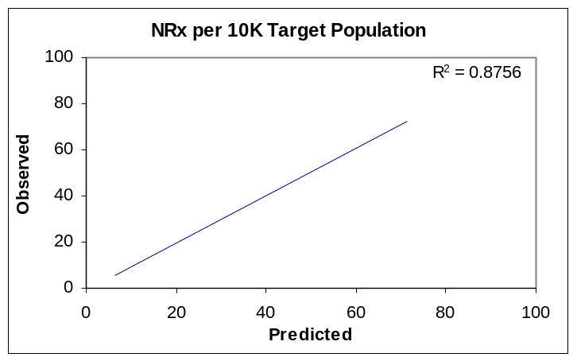
High Predictive Accuracy
Close correspondence of observed NRx volume to NRx volume predicted by the GRP-based model provides evidence of the robustness of the analytical results. The predicted accuracy of this model is similar to that achieved by prior analysis for other Merck brands.
Predicted values capture 87% of the variability in the observed monthly NRx per 10K target population.

Slide 10
Model Findings
Impact of various drivers of NRx volume agrees directionally well with the expectations. Singulair® TV DTC has negative impact on Nasonex® NRx volume.
Drivers | Impact on Nasonex NRx | Statistical Significant?
PDE | Positive | Yes
Samples | Positive | Yes
Vouchers | Positive | Yes
E-Detail / Telesymposia Events | Positive | Yes
Nasonex® TV DTC | Positive | Yes
Singulair® TV DTC | Negative | Yes
Spring Seasonal Months (March, April) | Positive | Yes
Secondary Seasonal Month (September) | Positive | Yes
Month of December | Positive | Yes
Lagged NRx (persistence) | Positive | Yes

Slide 11
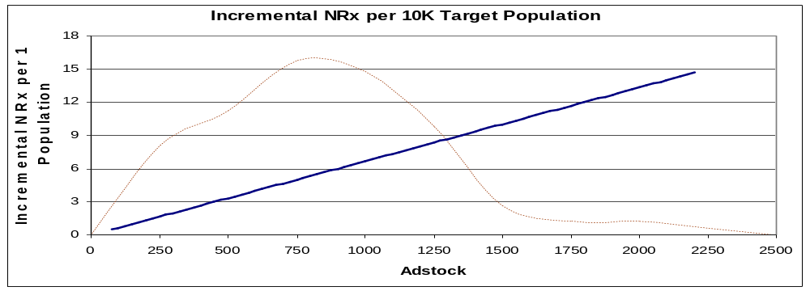
Sales Impact
The statistical modeling process used in this analysis results in a linear response as shown below. Point of diminishing returns was not discernable using the standard approach. The estimates have a greater degree of confidence around the average monthly adstock of about 740.
Average Monthly Adstock During Analysis Period
The dotted brown line shows the frequency of observations used in the model.
  Observations are concentrated around the mean adstock value of about 740 per month.
  Because most DMA-months during the analysis period are in this range, we have greater degree of confidence in the estimates within the adstock range of about 400 to 1200 than outside it.

Slide 12







Nasonex® DTC TV ROI
- May 2008 to October 2009
The GRP-based analysis shows that investments in Nasonex® TV campaigns resulted in a ROI of ≈ $4 : $1 based on branded campaigns between May 2008 through October 2009.
Before-Tax
After-Tax
➔
➔
➔
The GRP-based analysis model was used to estimate the impact of TV ad exposure on sales during the analysis time period¹.
÷
÷
Media cost , agency fees and production fees for ROI calculation.
This is the incremental revenue of the campaign divided by media, agency and production costs. This result indicates that both in before and after-tax scenario’s $4 of revenue was returned for each dollar invested in TV.
  The 95% confidence interval of ROI is (3.4 to 1, 4.5 to 1)
  A confidence interval is an interval in which a measurement or trial falls corresponding to a given probability. In this case, we are 95% sure that the true ROI lies between 3.4 to 1 and 4.5 to 1.
Price per Rx based on 2008 profit plan is used.
Effective tax rate for expenses is 40%

Slide 13
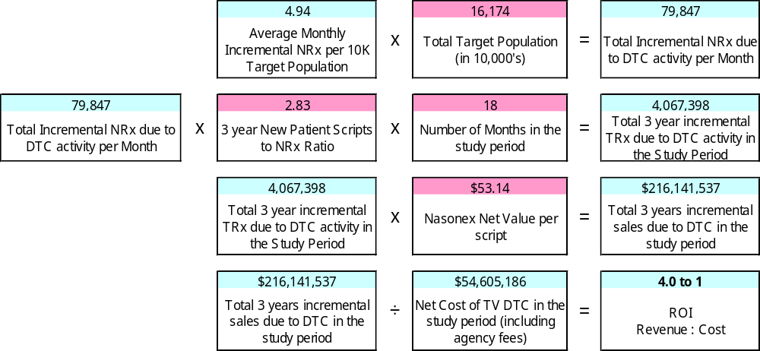
ROI Calculation – Before-Tax
This is a more detailed calculation of ROI. New Merck has adopted Legacy Merck’s financial models for revenue evaluations, where 3 year sales from a new patient is considered.
Using scripts generated by a new patient for 36 months, the ROI obtained is approximately comparable to Legacy Merck methods of calculating ROI. This results in an average ROI estimate of 4.0 due to the 18 months of DTC activity.
Note: Scripts generated by New Patient Start for 2 years is estimated to be 2.36.
Scripts generated by New Patient Start for 3 years is obtained by adding additional 20% to 2 year value of 2.36, resulting in 2.83

Slide 14
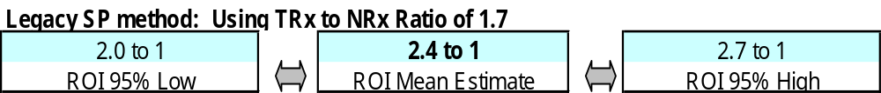
ROI Calculation – Legacy SP Method
Legacy SP method uses direct TRx to NRx ratio while converting incremental NRx to incremental TRx. Legacy SP approach leads to an equivalent ROI of 2.4. Any comparison to prior legacy SP analysis should use this ROI value.
New Merck has adopted Legacy Merck’s financial models for revenue evaluation as shown on the previous slide.
The Legacy SP method, which is more conservative than the legacy Merck method, uses the TRx to NRx ratio in computing incremental revenue. Based on this method, the average ROI estimate is 2.4 due to DTC TV in the 18 months study period.
The Nasonex DTC TV dynamics have changed significantly after Q4 2009. The DTC TV spend was reduced compared to previous years and the channel strategies might have changed. These factors have to be considered while comparing the previous results with the current ROI of 2.4 during the analysis period.

Slide 15
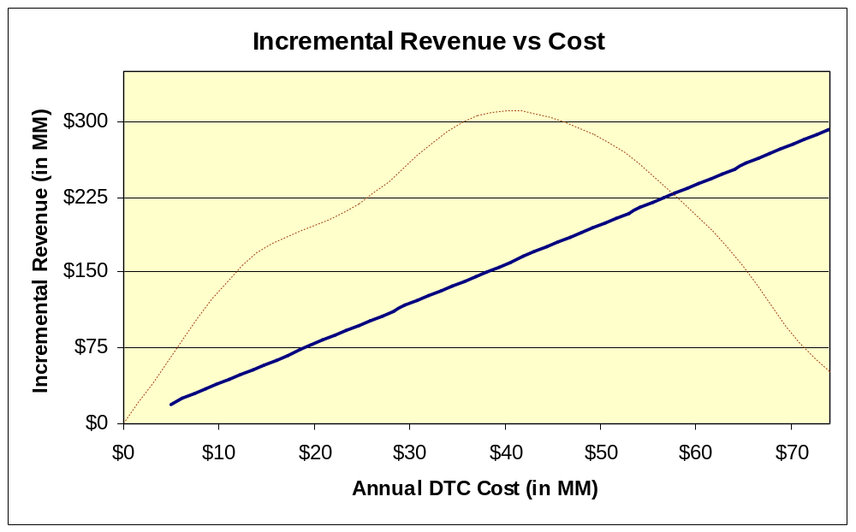
Incremental Revenue¹ by Total pre-tax Investment
This incremental revenue vs. pre-tax annual DTC TV spend chart shows a revenue of about $145 MM for the average pre-tax annual TV DTC spend of about $37 MM. The estimates have higher confidence in the narrow range around the mean annual spend.
Historical annual TV investment
The modeled curve is linear, implying that as DTC spend increases, the revenue also increases proportionately. Further non-parametric studies suggests that after about $37 MM annual spend, the growth in revenue decreases. However within the data experience range, the saturation effect could not be observed.

Slide 16
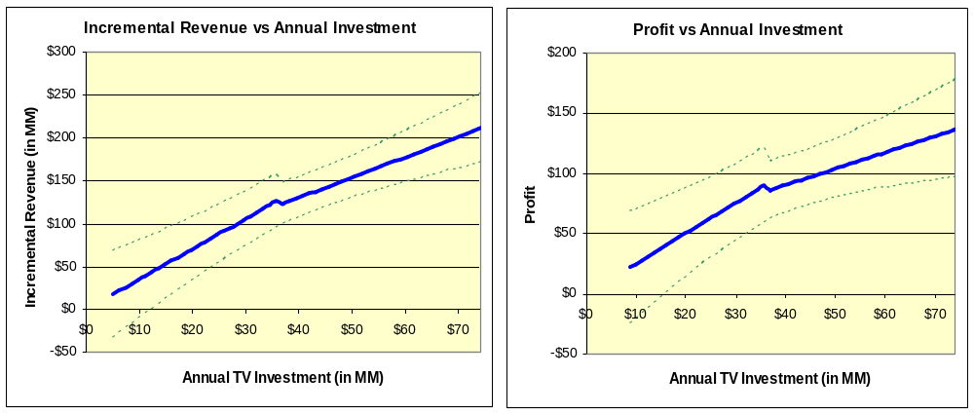
Non-Parametric Study: Incremental Revenue and Profit
Non-parametric studies provides more insights on the revenue and profit curves. Beyond annual pre-tax DTC spend of about 37 MM, the rate of growth in profit slows down, but still positive in the experience range.
Historical pre-tax TV investment of about $37 MM results in estimated before-tax profit of about $88 MM
Dotted green lines represents the 95% confidence intervals.
The linear model is good in estimating average ROI estimate. Non parametric studies are more flexible and provides insights about the revenue and profit curves. The blue line in the chart is average estimate and the dotted green lines represent 95% confidence limits.
The Incremental Revenue and the Profit curves show that the revenue and profit grows fast as the DTC spend increases up to the average current annual spend of about $37 MM. As the spending increases beyond the current annual spend, the rate of growth in revenue and profit reduces or flattens, but still positive.
Since the number of observations in the modeling process reduces drastically as we move away from the average annual spend, we are more confident in the predictive accuracy around the average annual spend than away from it.

Slide 17
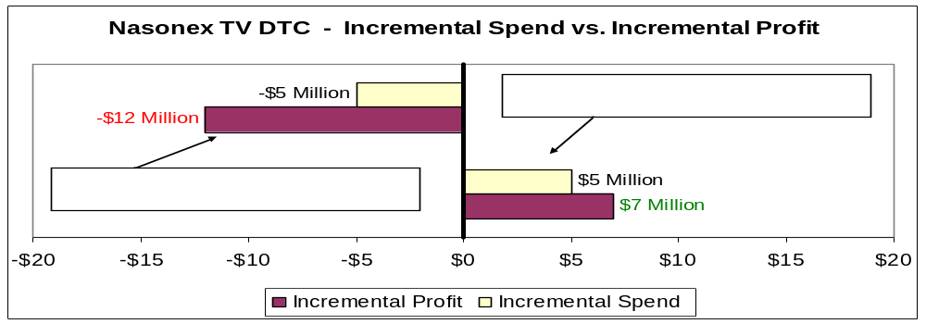
Non-Parametric Study: DTC Spend Levels
Non-Parametric study supports a 2010 annual DTC TV spend of about 42 MM, a $5 MM increase from historic level.
Scenario 1
Scenario 2
The current average annual spend for Nasonex DTC TV program is about $37M.
Scenario 1: By decreasing the average annual spend by $5 MM to $32M, the profit reduces by about $12M. Hence, a decrease in current spend level is not recommended.
Scenario 2: By increasing the annual spend by $5MM to $42M, profit increases by about $7M. The profit growth rate is low, but still positive.
As the predictive accuracy of estimates are better in the neighborhood of current average spend, an annual DTC TV spend of about $42M is recommended.

Slide 18
Conclusion
This analysis suggest that investments in Nasonex TV media, production and agency fees were profitable during the studied time period (May 2008 through October 2009) with an approximate ROI of $4 : $1.
The estimated ROI was about $2.4 : $1 when the ROI was computed using Legacy SP methods.
The response curve analysis suggest:
  that historical investments were approximately optimal with respect to incremental revenue due to branded TV ads, and
  that an increase in media investment of approximately 10% to 15% vs. historical investments may increase the profits from the investment.
This analysis is best used to inform relative investment decisions rather than as a measure of absolute ROI.

Slide 19
Fair Balance
General Comments
  The analytical methods applied here leverage naturally-occurring variability in sales, promotion and advertising over time and geography, and are useful for informing decisions regarding adjustment of DTC TV advertising expenditure within the range of current (analyzed) spending levels. Using these analyses to make inferences about return on investments far below or far above the level of investment analyzed here may be invalid.
  The present analytical results estimate retrospective ROI for DTC advertising for an 18-month historical time period. To be leveraged appropriately for making resource allocation decisions, these retrospective results need to be interpreted in the context of future potential patients, brand messages, competitive dynamics, market events, product life cycle, and other influences.

Slide 20
Fair Balance
Nasonex® Considerations
  This analysis examined the direct effects of TV without controlling for print and online ad exposure since print exposure tends to be highest when TV exposure is highest and vice versa. For these reasons, the sales impact of TV reported here is likely to include some of the impact of print and online media as well.

Slide 21
Appendix

Slide 22
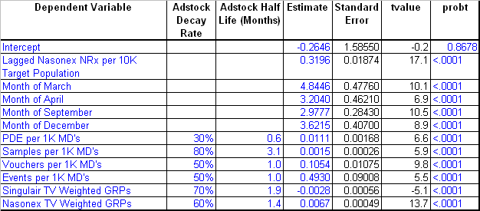
Model Estimates
Impact of various drivers of NRx volume agrees directionally well with the expectations. Singulair TV DTC has negative impact on Nasonex NRx volume.

Slide 23
Method Overview & Benefits
GRP-based analyses study large-sample response to TV ads & are standard throughout our industry.
Overview: GRP-based analyses leverage variability in audience exposure to TV ads across time and geographic areas to provide a robust estimate of the effect of these ads on sales.
  Variability in GRPs/DTC advertising pressure occurs…
    across time because of variable flighting patterns and viewing habits, and
    across geographies because of differences in regional audience composition, viewing habits and local “spot” TV where applicable.
  Time-series cross-sectional statistical regression models are used to estimate the independent incremental impact of TV ads on NRx sales while controlling for baseline scriptwriting, concurrent field sales promotion, seasonality, and market events.
Benefits: Assessment of DTC advertising sales impact and ROI using GRP-based analysis can be executed in-house at a low cost, and allows benchmarking against other pharmaceutical brands.
  Extensive evaluation of available approaches was done to identify this best-practice approach (e.g., vendor capabilities assessments and review of academic and industry literature).
  This is a standard method in the pharmaceutical industry and for consumer packaged goods.

Slide 24
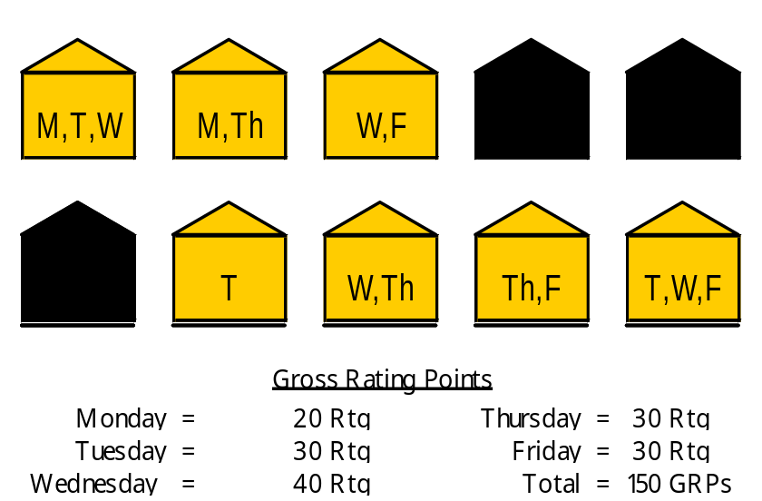
Gross Rating Points
GRPs provide a standard measure of exposure to a DTC advertising campaign based on TV viewing.
Definitions
  Rating: percentage of TV households tuned into an episode of a particular program
  Gross Rating Points (GRPs): sum of all ratings during a specific time period
  Following is an illustration of Ratings and GRPs for an exemplary universe of ten TV households over a five day period measuring a program airing Monday through Friday:
  Described another way, GRPs represent the gross duplicated percentage of households reached by a particular campaign (reach * average frequency).
This is an example of daily ratings for a program airing once each weekday, summarized into GRPs for a one-week time period. GRPs for a particular campaign are computed by adding the ratings for all of the individual programs during which the commercial(s) aired over the time period of interest.

Slide 25
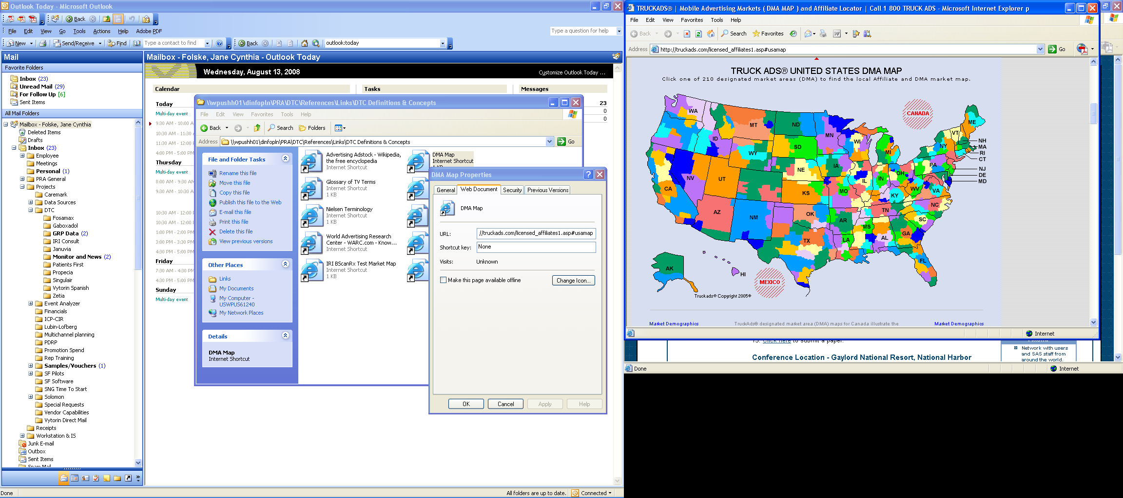
Regional Ad Exposure
GRPs are available by DMA to capture regional differences in TV viewing habits & ad exposure.
Description
  Weekly GRPs are available by creative execution for each of the 210 local Designated Market Areas (DMAs).
  Local Nielsen ratings are projected from a large sample of TV households across the US, selected randomly to insure unbiased estimation of national viewing habits (e.g., the New York sample alone consists of 828 households).
  Merck purchases data for the top 100 DMAs which characterize approximately 65% of the US population.

Slide 26
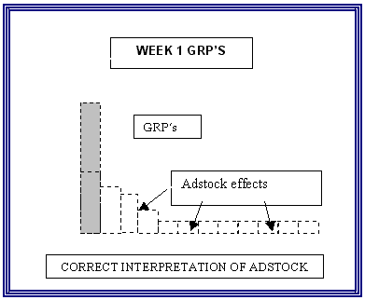
Data Transformations
Lagged effects (carryover) of DTC ads & other forms of promotion are included using adstock.
The adstock transformation is based upon prior research and has been adopted as standard practice for GRP-based analysis and other marketing mix modeling processes.
  For example, the effects of current GRPs
  in future weeks are captured by adding a
  portion of Week 1 GRPs to GRPs in
  Weeks 2, 3, and beyond. The portion
  of GRPs to be carried forward is
  estimated during the modeling process.
http://www.ephrononmedia.com/article_archive/articleViewerPublic.asp?articleID=97

Slide 27
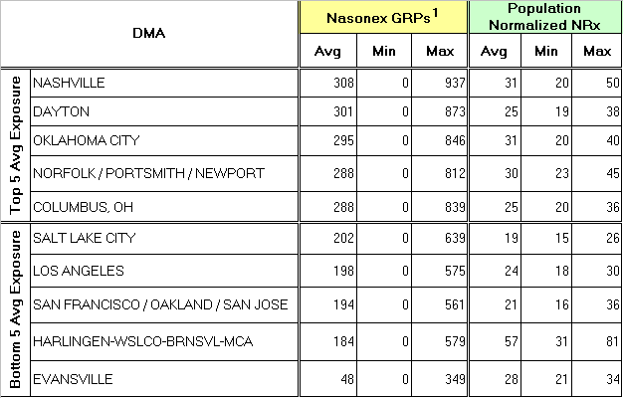
Nasonex® TV Case Study
GRPs varied from 0 to 937 across DMAs and months between May 2008 and October 2009, providing more than adequate variability to study the impact of the TV campaign.
Average monthly Nasonex ad exposure varies considerably across DMAs and ranges widely from no expsure to high levels of exposure.
1. Raw GRPs have been equivalized to a 30 second duration, so that reported GRPs for 60 second ads are doubled, and reported GRPs for 15 second ads are halved.

Slide 28
Notes Regarding Reach and Frequency
Planned reach and frequency are functions of existing awareness, seasonality, population size and complexity of message.
GRPs capture both reach and frequency in a single metric and therefore do not distinguish two DMAs with the same realized GRPs in a given month from one another according to these important drivers.
That said, it is important to note that the flighting of GRPs into the marketplace is a result of a carefully designed media plan, deliberately designed to deliver reach and frequency goals against a target audience.
For example, for asthma, a 3+ monthly frequency with lower reach may be recommended.

Slide 29
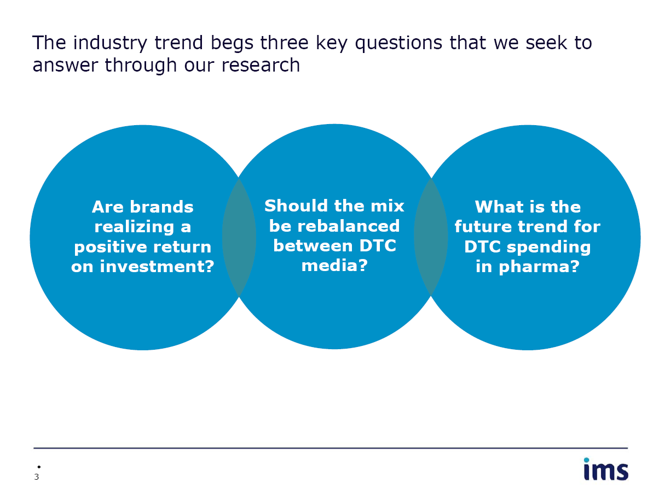
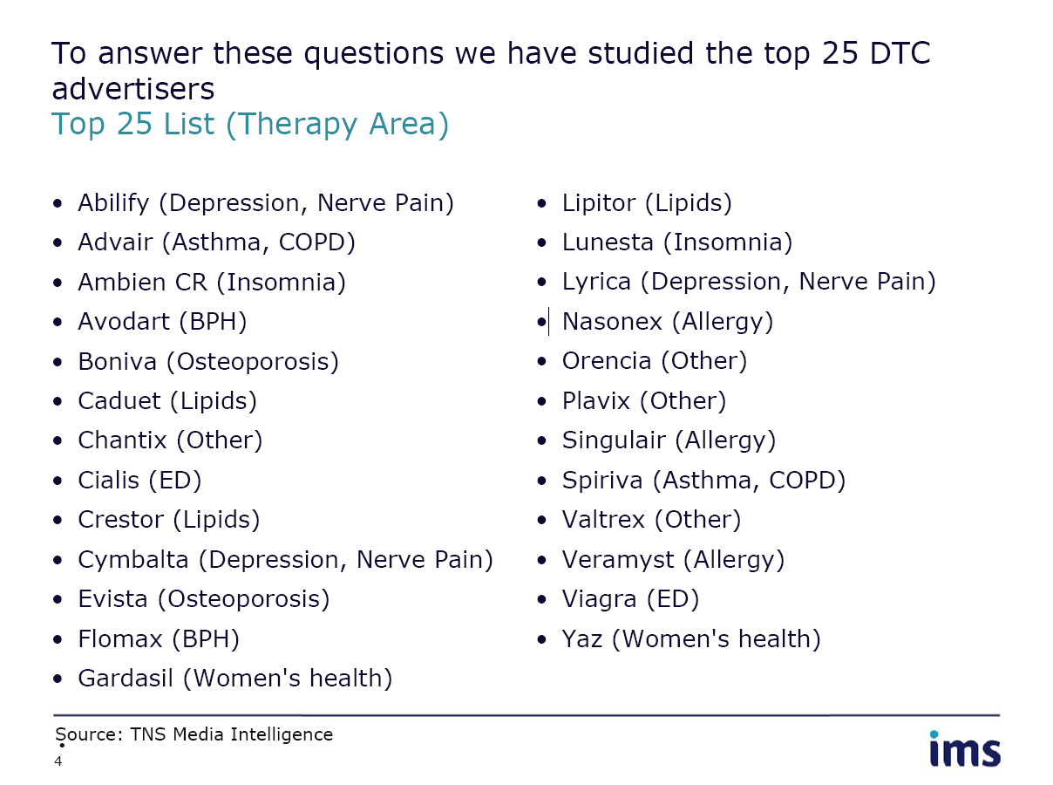
Industry Benchmarks...
...are available for the top 25 pharmaceutical advertisers in 2008, including multi-billion dollar brands.

Slide 30
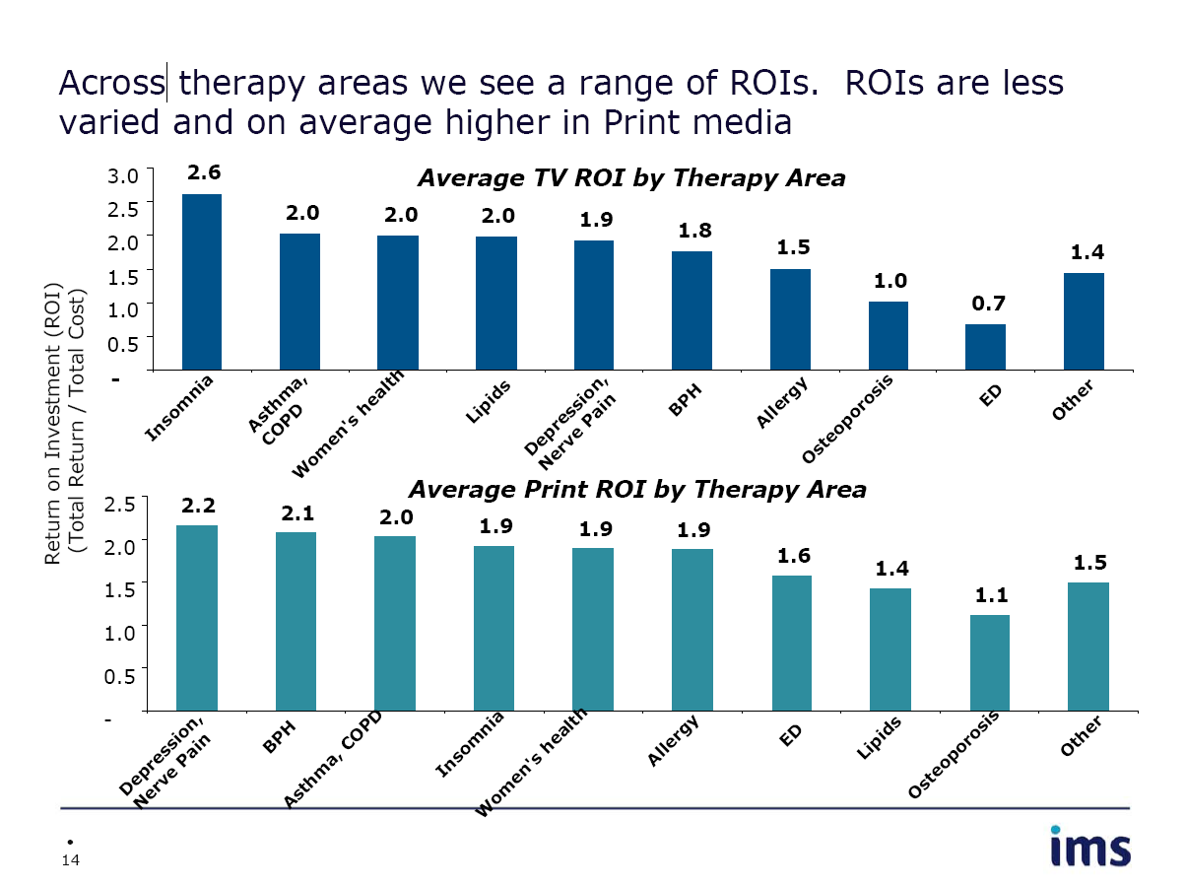
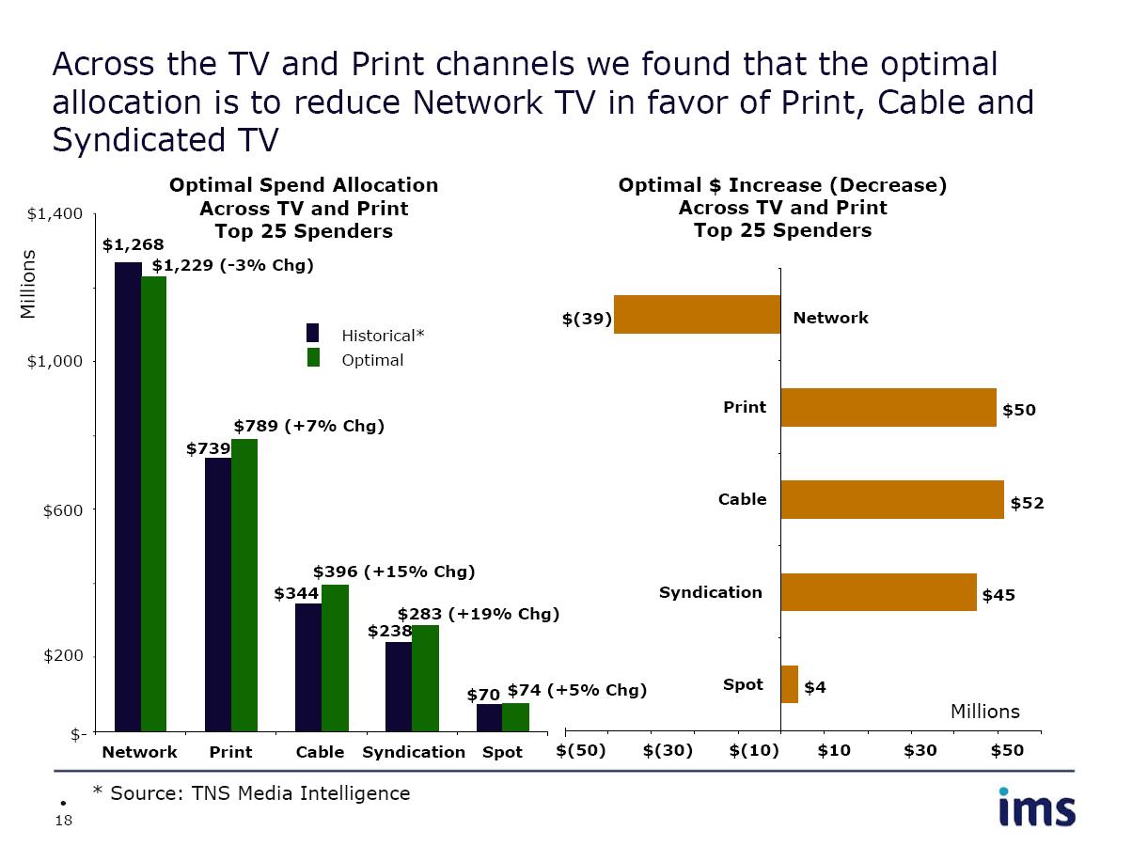
Industry Benchmarks...
...for the top 25 Rx 2008 DTC campaigns varied from unprofitable to approximately $2.6:$1 for TV.

